Slide 1
Year 5 | Week 1 | Day 1

Slide 2
Year 5 | Week 1 | Day 2

Slide 3
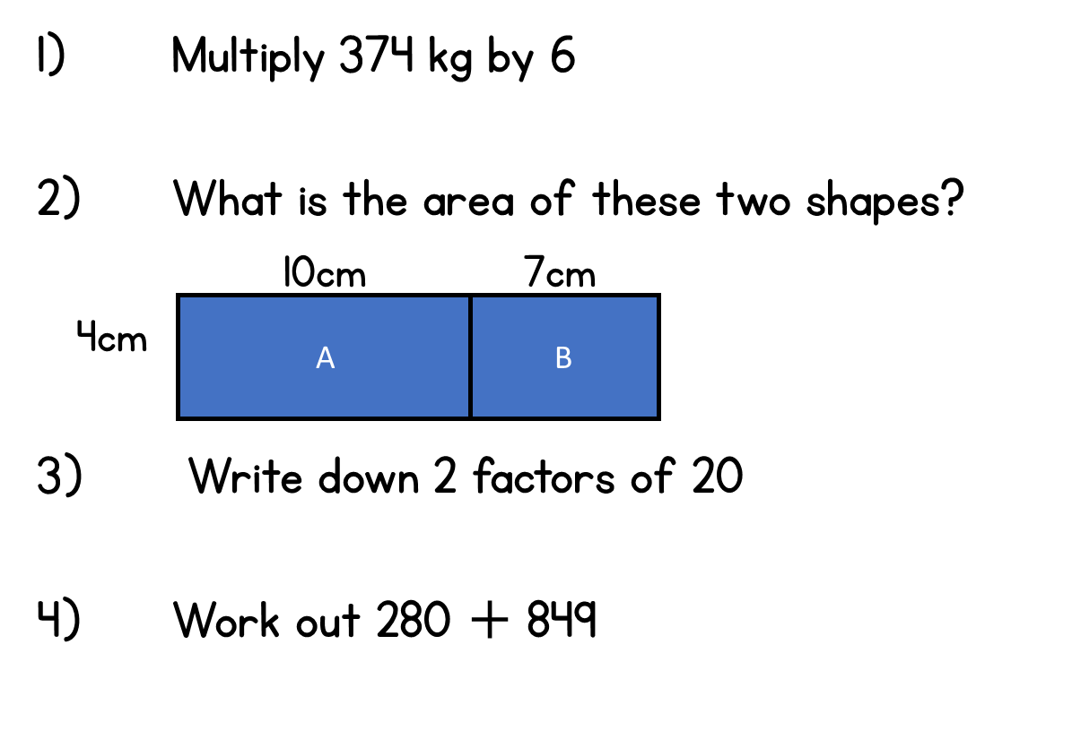
Year 5 | Week 1 | Day 3

Slide 4
Year 5 | Week 1 | Day 4

Slide 5
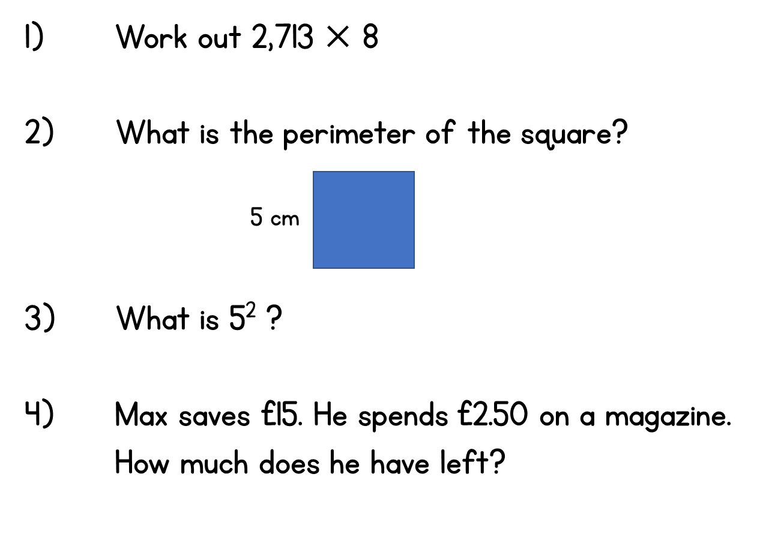
Year 5 | Week 1 | Day 5

