Slide 2
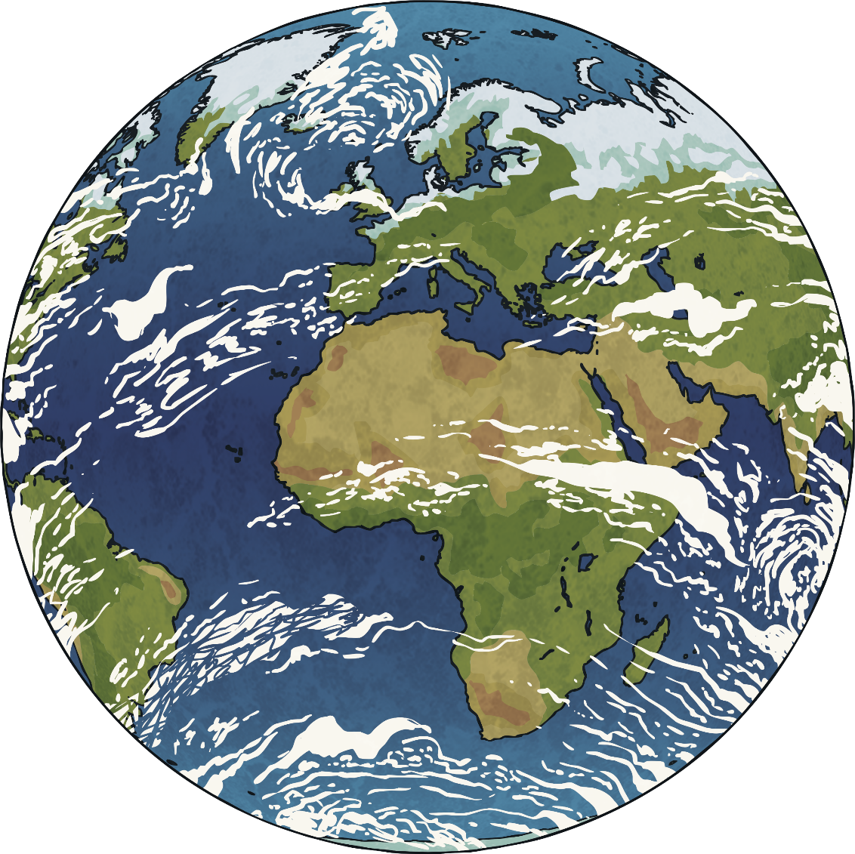
Watch the BBC Teach Blue Planet Live Lesson with your class.

Slide 3
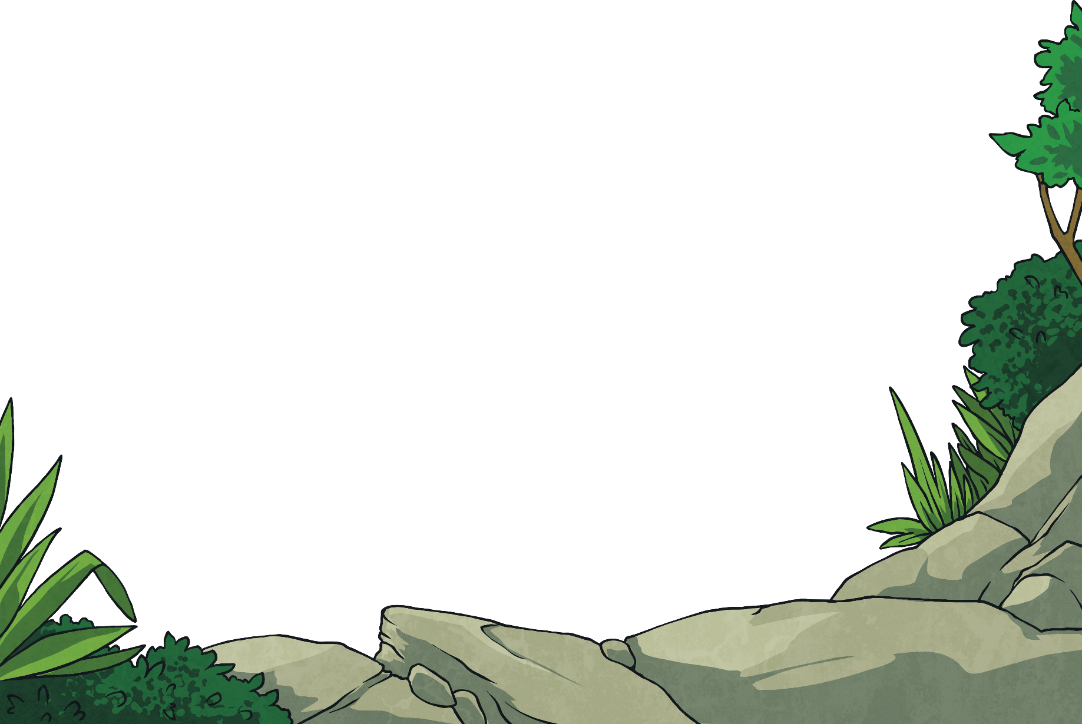
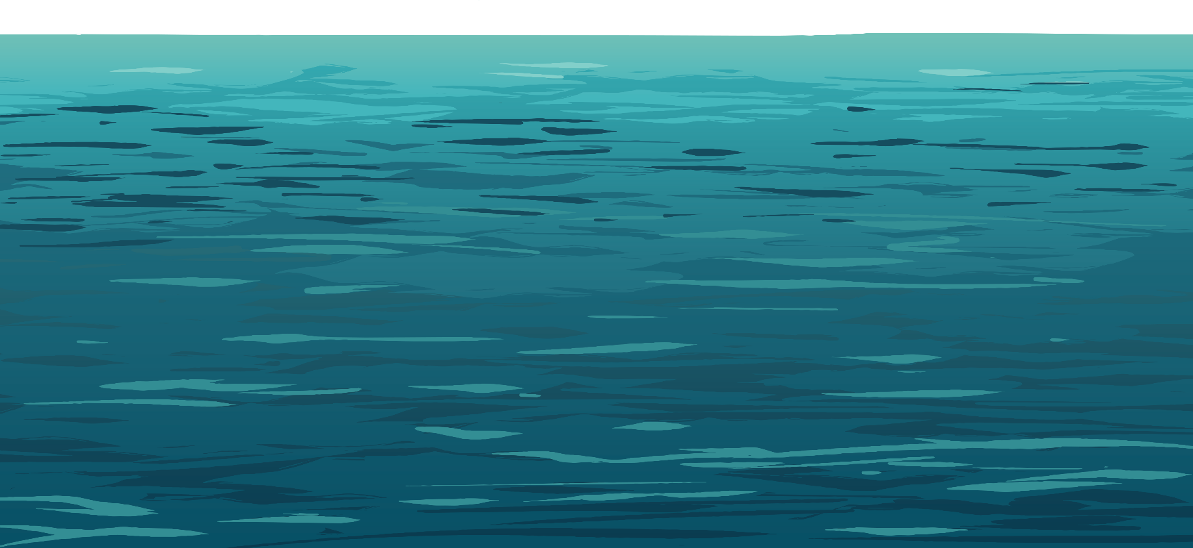
Did You Know…?
There is a greater variety of life in the world’s oceans than anywhere on land.
All our oceans are connected, so we need to keep them all healthy!
There are many threats to marine life, including plastic pollution, overfishing and global warming.
marine life
pollution
overfishing
global warming

Slide 4
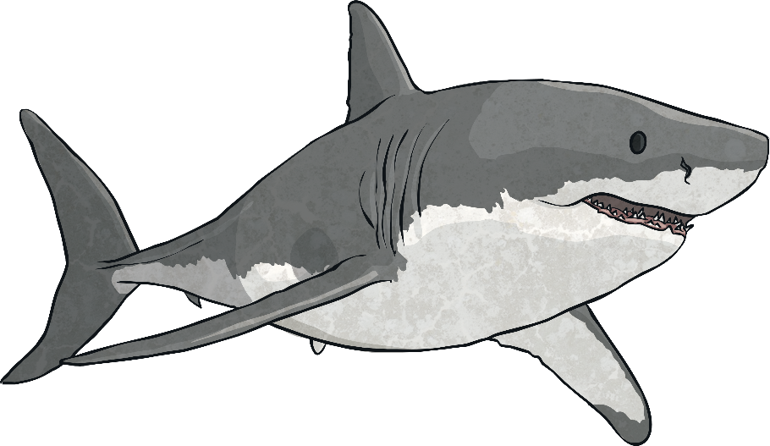
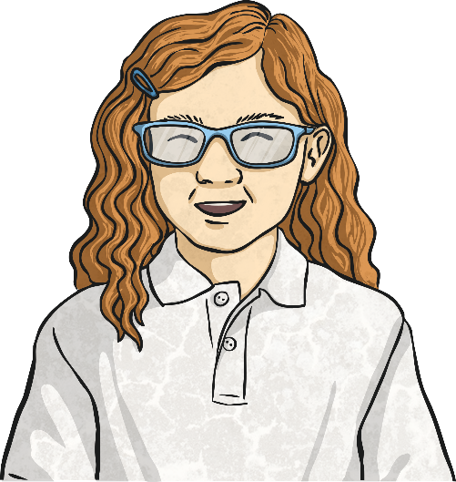
Save Our Sharks!
One of the species in danger because of these issues is the shark.
How do you think overfishing affects the shark population?
Think, pair,
share.

Slide 5
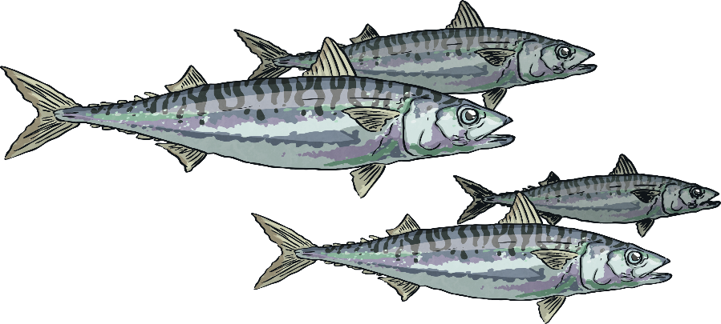
Overfishing
If tuna are overfished, then sharks may not have enough to eat. This could lead to an imbalance in the food chain and sharks becoming a dying breed.
If mackerel are overfished, tuna will not have enough to eat, leading to them becoming a dying breed and as a result, sharks too.
Sharks play a major role in the ocean ecosystem, so it is important that they remain part of it.

Slide 6
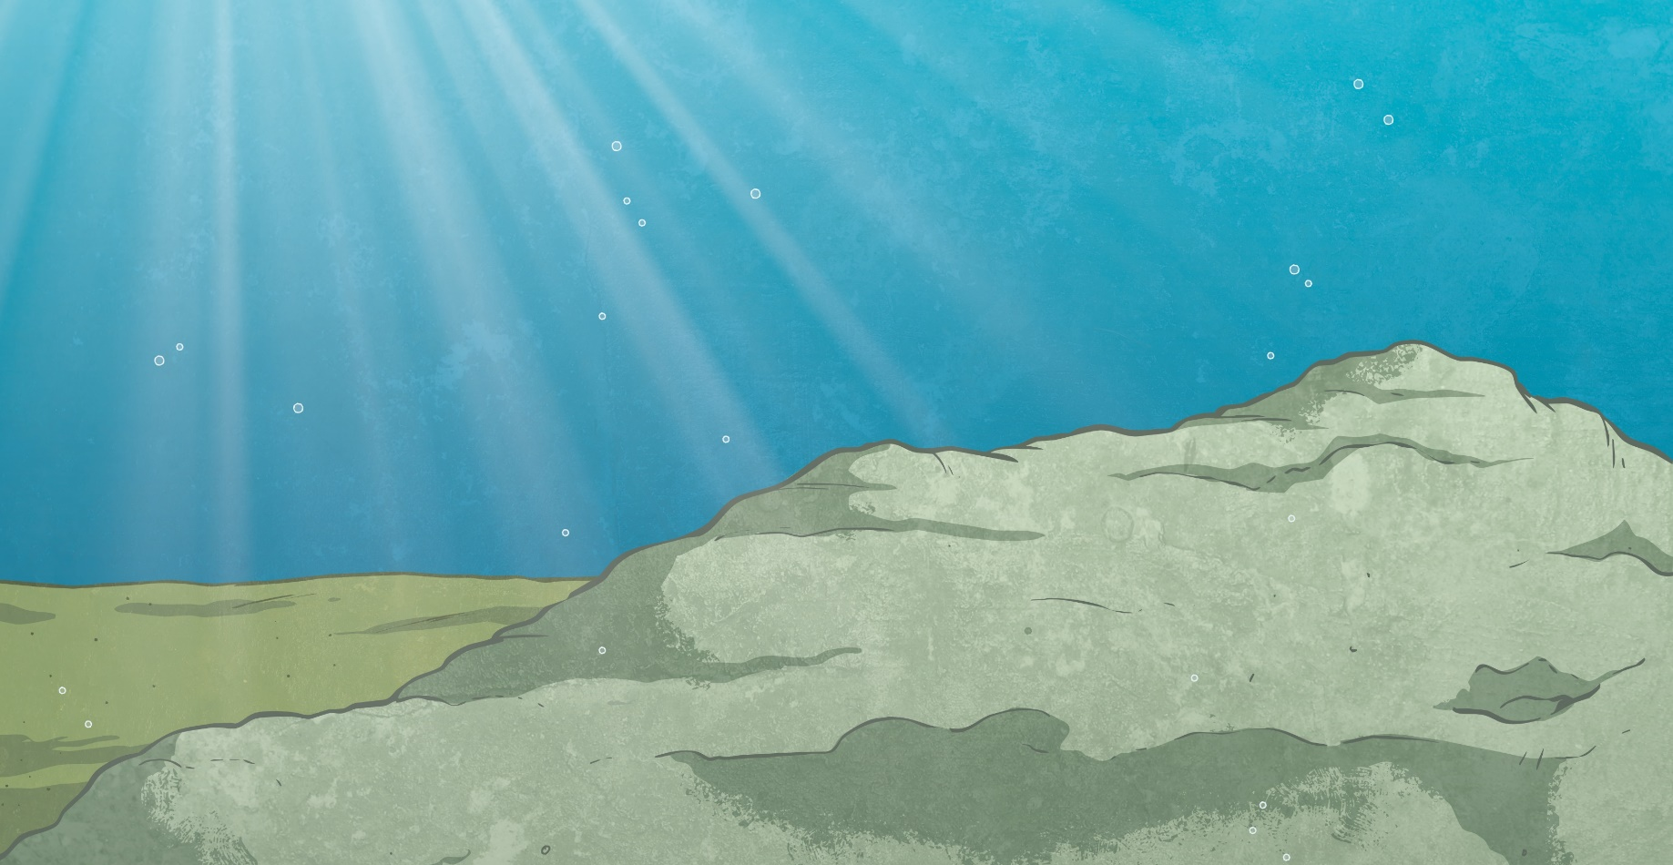
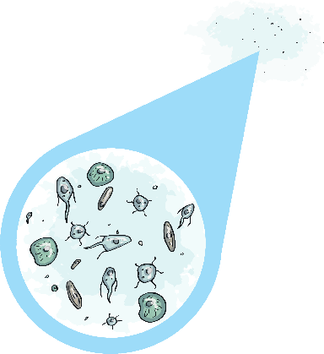
Overfishing
Take a look at the diagram below. All these creatures play an important part in this food chain, even those too small to see.
sunlight
single-celled organisms
small
fish
mackerel
shrimplike creatures
large shark
tuna

Slide 7
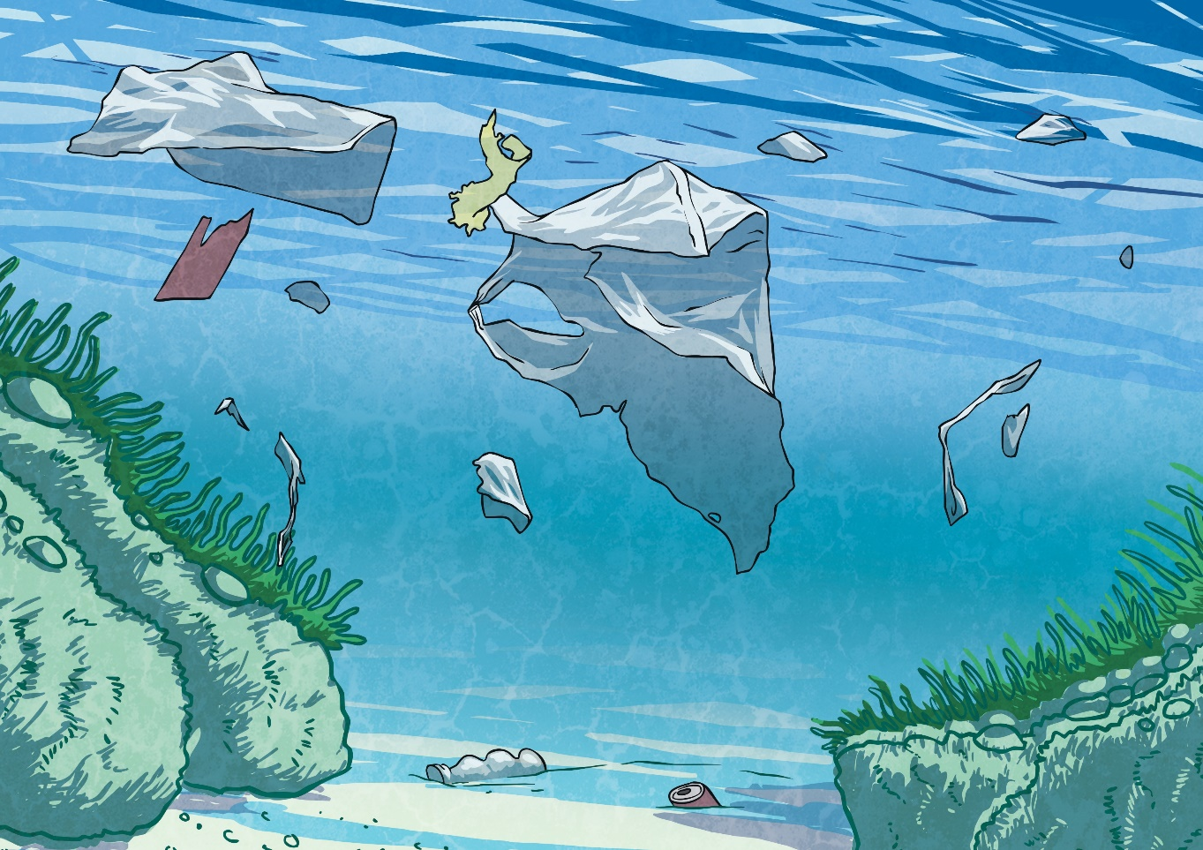
Plastic Pollution
Many plastics do not biodegrade.
biodegrade
Plastic is harmful to ocean life.

Slide 8
Plastic Pollution
Many plastics cannot be burned, because they release harmful gases into the air. This can affect global warming, raising the temperatures in seas so that they become unsuitable for some types of marine life.
Littering causes plastic to enter our oceans, where it can endanger wildlife. For example, turtles may think a plastic bag is a jellyfish and eat it.
Think, pair,
share.
How might plastic pollution affect sharks?

Slide 9
How Can You Help?
Eat sustainable fish (the Good Fish Guide is useful to see which fish to eat and which to avoid).
Eat less fish.
Raise awareness of the importance of sharks to the ocean ecosystem.
ecosystem
Use less plastic.
Recycle plastic where you can.
Start an eco initiative in school or at home, encouraging others to reduce, reuse and recycle plastic.

Slide 10
Save Our Sharks Persuasive Leaflet Activity
Create your own leaflet informing people of the importance of sharks to the ecosystem and persuading them to take action to help protect sharks.
Top tips:
Use your introduction on the cover page to explain why sharks need protecting.
Give some examples of what might happen if the shark population declined.
Include a labelled diagram of an ocean food chain.
Persuade your readers that sharks aren’t to be feared, but protected, by including some fun facts about sharks.
In your conclusion, remind readers of what they can do to help protect sharks and other marine life.
declined

Slide 11
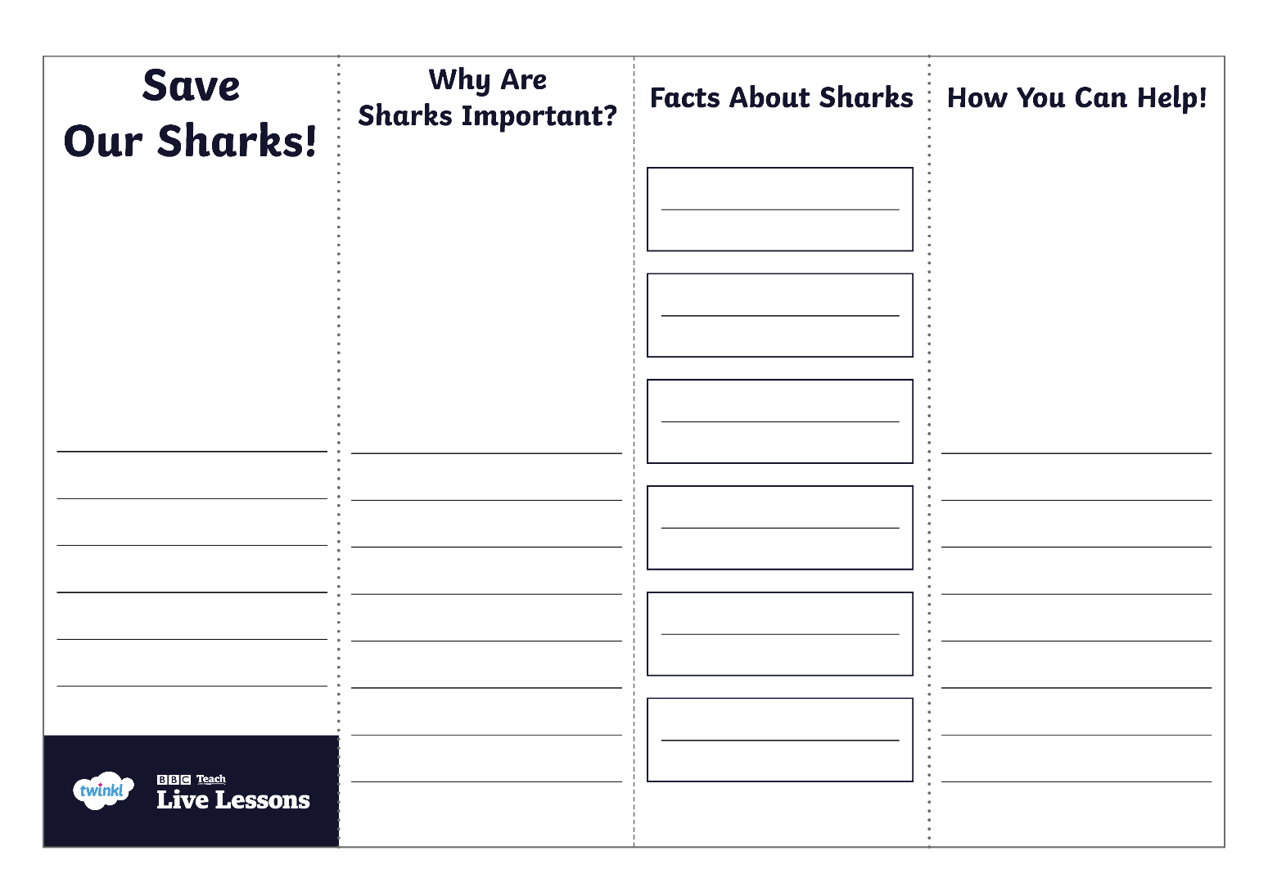
Save Our Sharks Persuasive Leaflet Activity

Slide 12
Glossary
biodegrade: To break down or decompose into natural materials.
declined: To become fewer.
ecosystem: All living and non-living things within an area.
global warming: A process that is causing the Earth’s temperature to rise.
marine life: Plants and animals that live in the sea.
overfishing: Catching too many of a particular type of fish, resulting in lower population levels.
pollution: Something that has a harmful effect on the environment.

