Slide 1
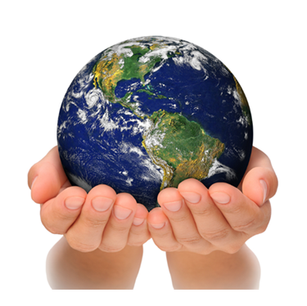
Justice for the good of all
This Photo by Unknown Author is licensed under CC BY-SA-NC
This Photo by Unknown Author is licensed under CC BY-NC-ND

Slide 2
Think about the phrase ‘that’s not fair’. Discuss what this means and why it upsets people when something unfair happens.

Slide 3
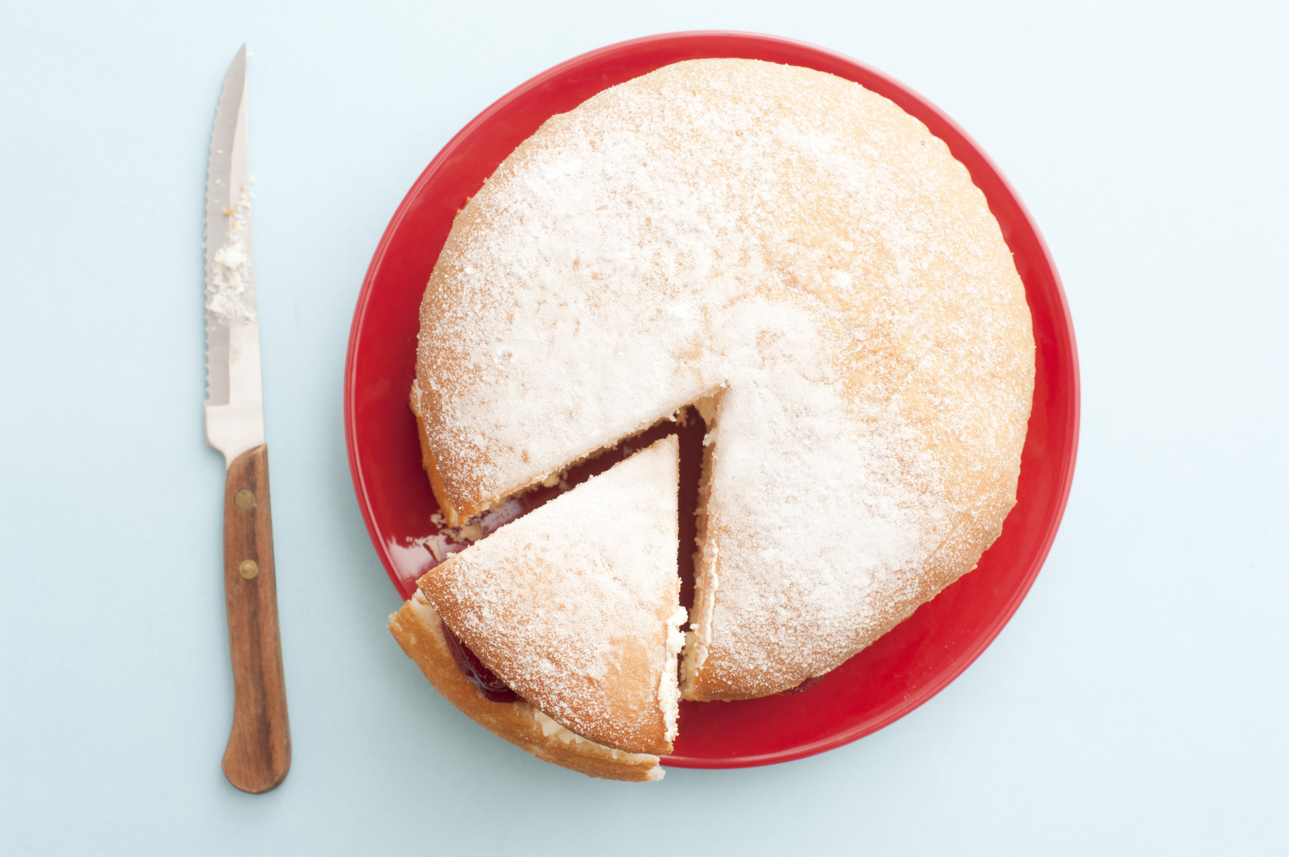
Fairness is about everyone having an equal share of something or being treated exactly the same. For instance, fairness would mean giving each person the same sized slice of cake, even if they have already had one. Justice is more than fairness. Justice might mean taking into consideration whether one person has had nothing else to eat that day and giving them a bigger slice of cake than someone who has just had dinner. Being just does not always mean being fair.
This Photo by Unknown Author is licensed under CC BY

Slide 4
Think of a time when you have been treated unfairly. Consider if the incident you thought of was unfair/just and why.
SOME KEY QUESTIONS How and by whom were you treated unfairly/unjustly? Why do you think it happened? How did the unfairness/injustice make you feel? What could the person have done differently to make the incident fair/just for you? Why do you think it is important to consider what is good for other people?

Slide 5
CAFOD, the Catholic Agency for Overseas Development, works to help stop injustice and unfairness around the world (globally) and to build a world which is a just and good place for everyone to live.
This Photo by Unknown Author is licensed under CC BY-SA-NC

Slide 6
TASK:
Write a persuasive letter to a friend thinking of ways you can look after vulnerable people/people in need. Explaining why through Jesus’ teaching, Gospel values, CST they should be doing this.

Slide 7
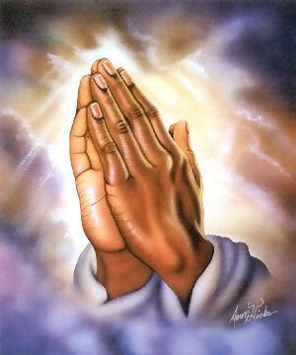
REFLECTION
For those who are not treated with respect… We join with them in hope For those who stand against injustice. We join with them in hope For those who are affected by earthquakes and floods… We join with them in hope For those who do not have enough food… We join with them in hope For those who do not have clean water… We join with them in hope For those who are suffering because of war… We join with them in hope For those who work for the good of others We join with them in hope We remember the times we have not been treated fairly and how we felt. We join together in hope and action to help build a more just world for the good of all.

